Slide 1
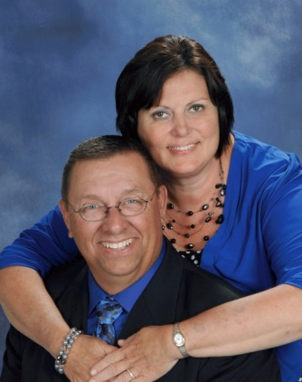
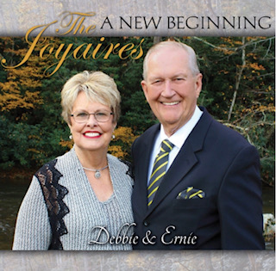
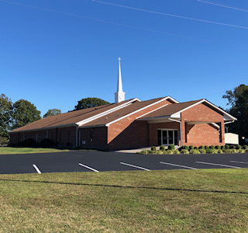
Fall Revival
Victory Baptist Church
475 JP Taylor Road
Henderson, NC 27537
252-492-6079
September 12-15, 2021
Sunday 11 AM & 6 PM
Mon.-Wed. 7:30 PM
Evangelist:
Steve Wagers
Host Pastor:
Rev. Ricky R. Easter
Everyone Welcome!
Special Singing Nightly by the Joyaires

