Slide 1
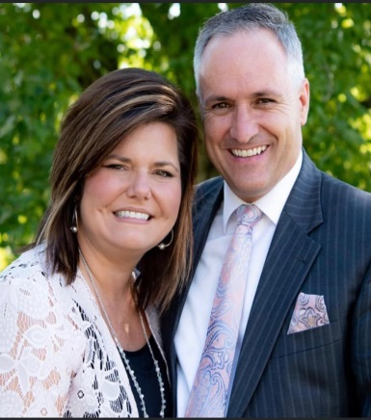
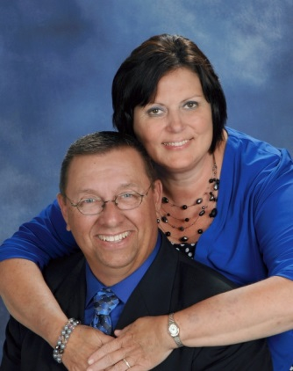
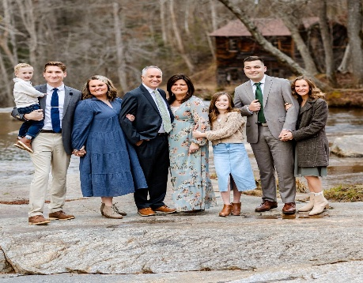
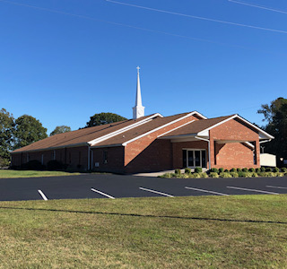
Spring Revival
Victory Baptist Church
475 JP Taylor Road
Henderson, NC 27537
252-492-6079
April 13-16, 2025
Sunday 6:30 PM
Mon.-Wed. 7:30 PM
Evangelist:
Scott Matthews
Host Pastor:
Rev. Ricky R. Easter
Everyone Welcome!
Special Singing Nightly
The Matthews Family
Victory Baptist Church

