Slide 1
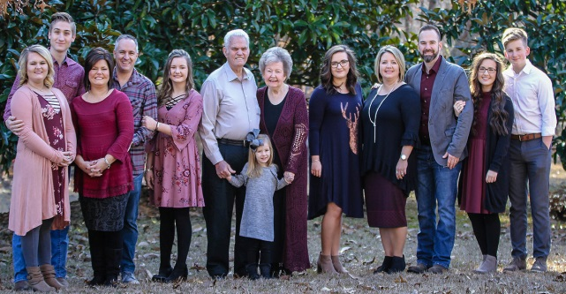
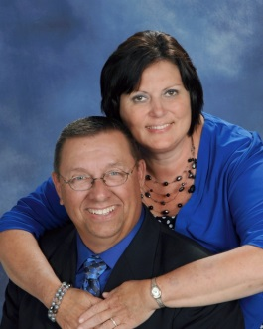
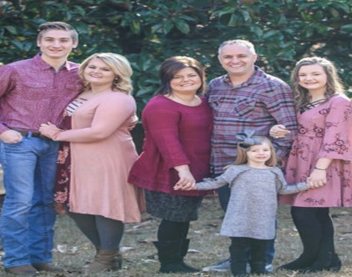
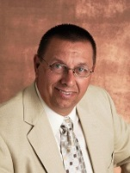
Spring Revival
Victory Baptist Church
475 JP Taylor Rd Henderson, NC 27537
April 11-14, 2021
Sunday 11:00 AM The Rochester’s Singing & Bro. Scott Matthews Preaching
Mon-Wed 7:30 PM The Matthew’s Family Singing & Bro. Scott Matthews Preaching
The Rochesters
Rev. Ricky R. Easter
The Matthews Family
Pastor

